Slide 1
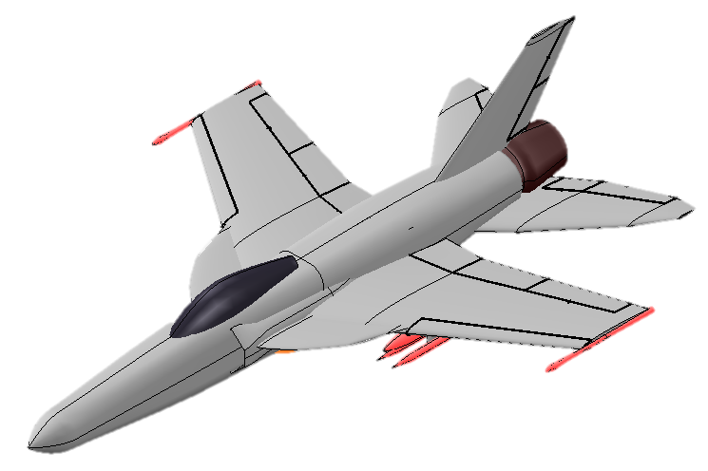
AVION YF-52 Coyote
Preliminary Design Review
Charlie Stone ∙ Valeria Cecena ∙ Quinn Kennerly
Lena Pattamadilok ∙ Jose Hernandez Negrete ∙ Mostafa Hashem

Slide 2
Objective
Objective: Design a carrier-capable supersonic strike aircraft that breaks cost trends.
Performance Requirements:
Mach 1.6-2.0 high altitude dash capability
Carrier compatible configuration
TOGW under 90,000 lbs
700-1000 nm. combat radius
Cut costs lower than:
R&D cost of $2 trillion for F-35 program
Unit flyaway cost of $102 million for F-35C
Ludwigson, Maurer 2024
Notes:
Harvey said: we do not need to include a slide about the RFP; it can just be referenced through the other slides
I added costs to this slide, source:
https://www.gao.gov/blog/f-35-will-now-exceed-2-trillion-military-plans-fly-it-less

Slide 3
Overview: YF-52 Coyote
YF-52 Concept:
R&D cost: $27 billion
Unit cost: $55 million
Gross weight: 36700 lb
Engines: 1
Total thrust: 33500 lb
Wing area: 400 sq ft
F-35 Lightning II:
R&D cost: $2 trillion
Unit cost: $102 million
Gross weight: 50000 lb
Engines: 1
Total thrust: 43000 lb
Wing area: 460 sq ft
F/A-18E/F Super Hornet:
R&D cost: $10 billion
Unit cost $72 million
Gross weight 47000 lb
Engines: 2
Total thrust: 44000 lb
Wing area: 500 sq ft
Hill, 2024
Notes:
Source: previous and https://www.slashgear.com/1689259/f-18-super-hornet-fighter-jet-price/

Slide 4
98% decrease in development cost.
46% decrease in unit cost.
Ludwigson, Maurer 2024

Slide 5
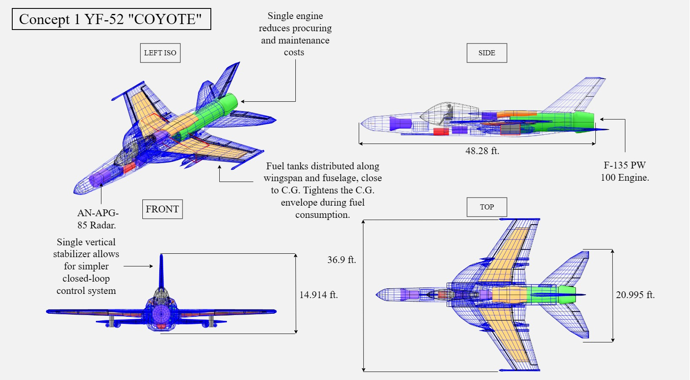
Dimensioned three-view drawing of the COYOTE

Slide 6
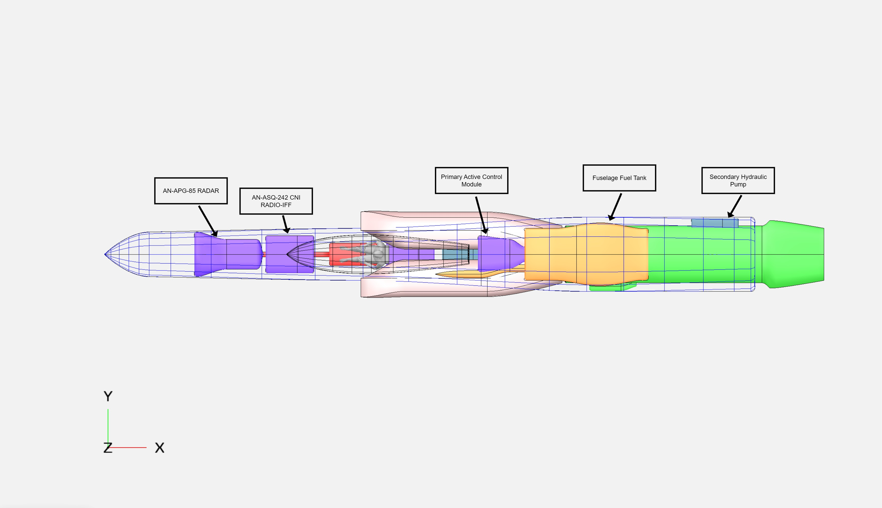
Fuselage

Slide 7
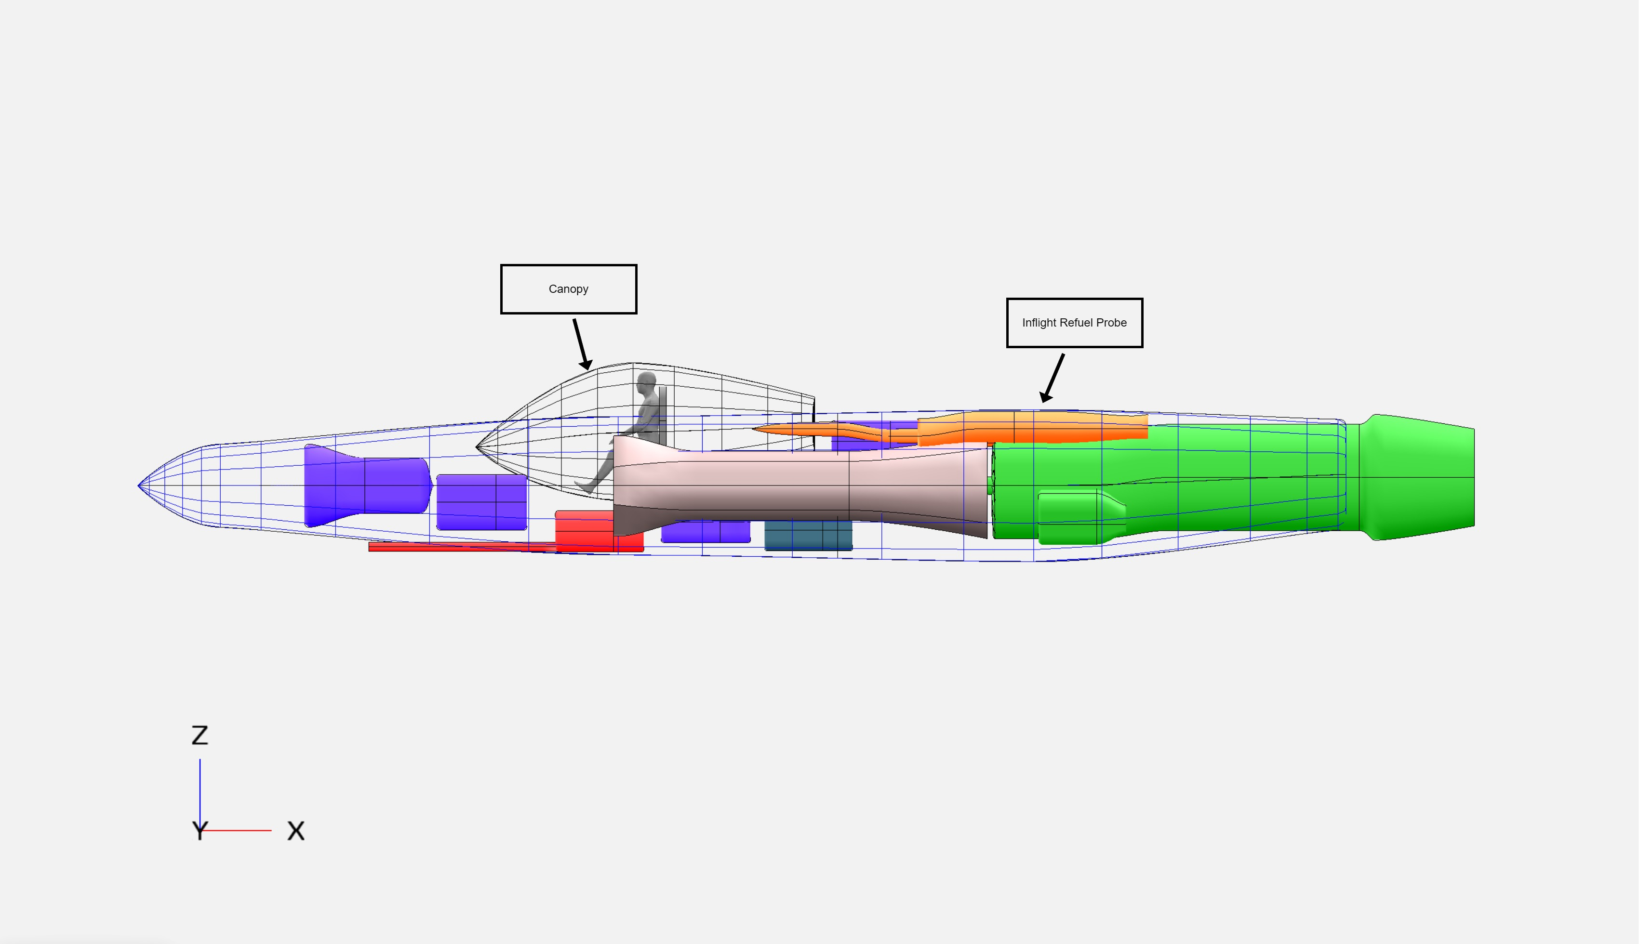
Fuselage

Slide 8
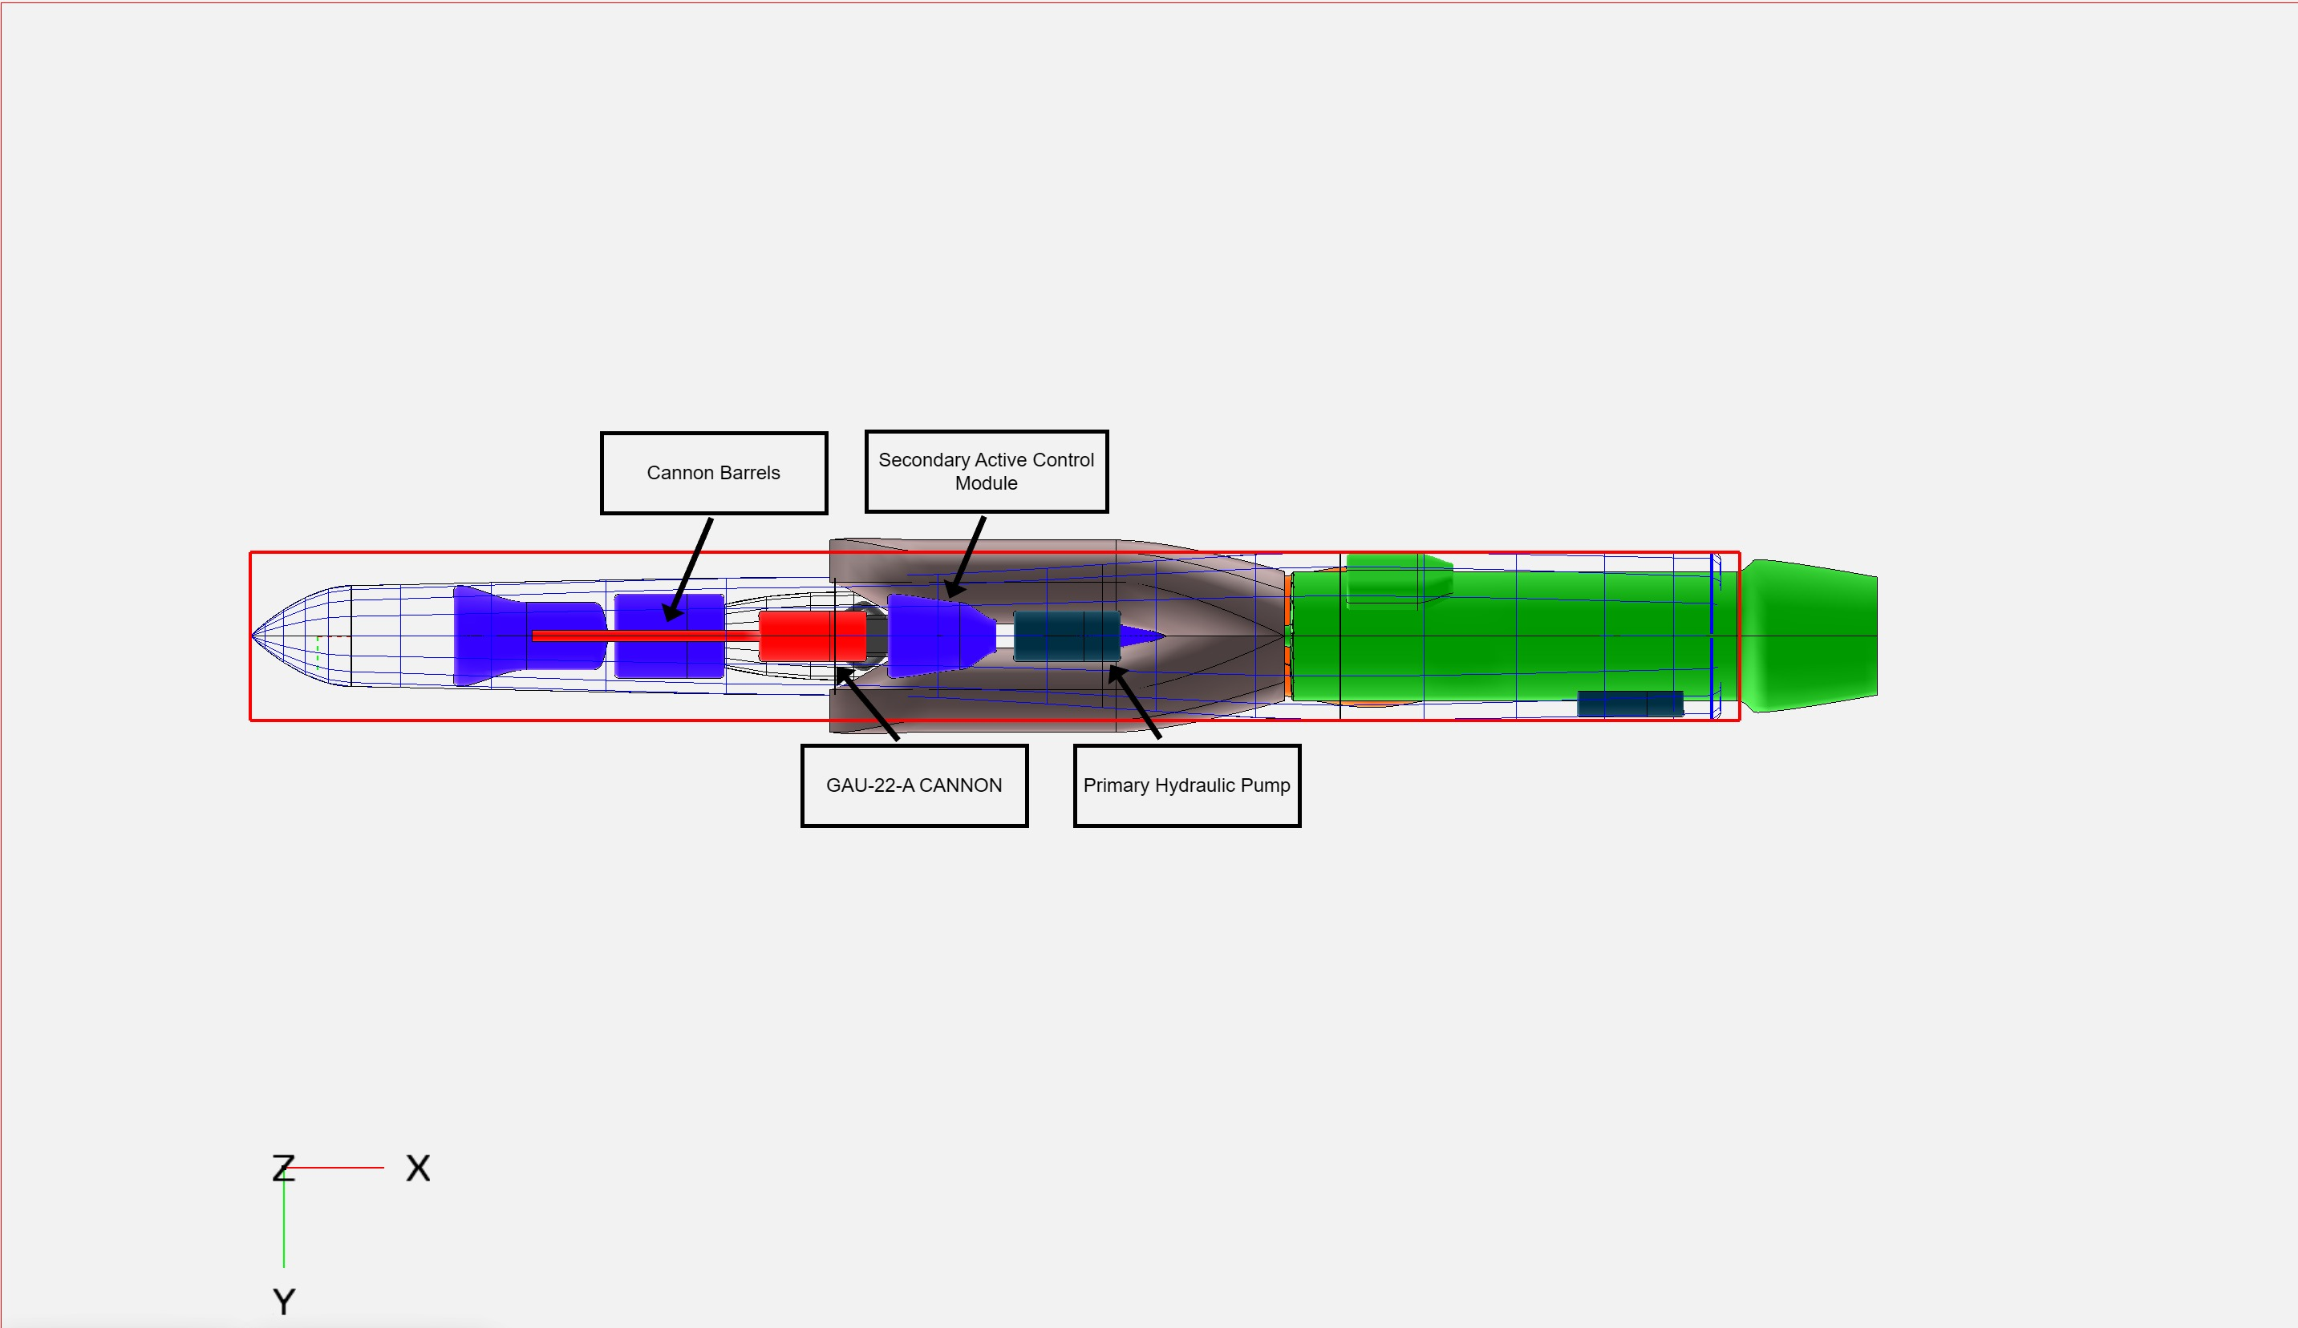
Fuselage

Slide 9
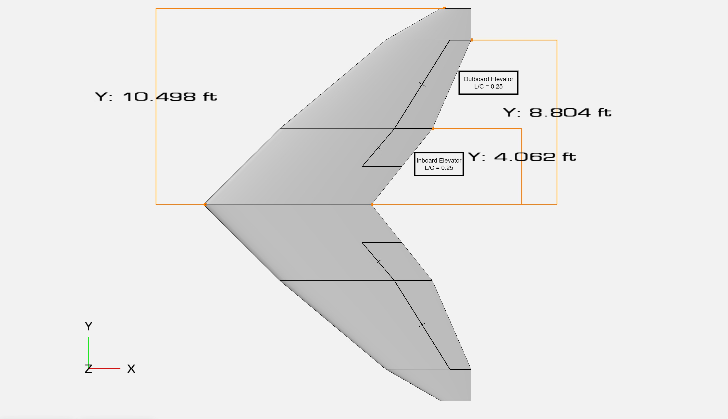
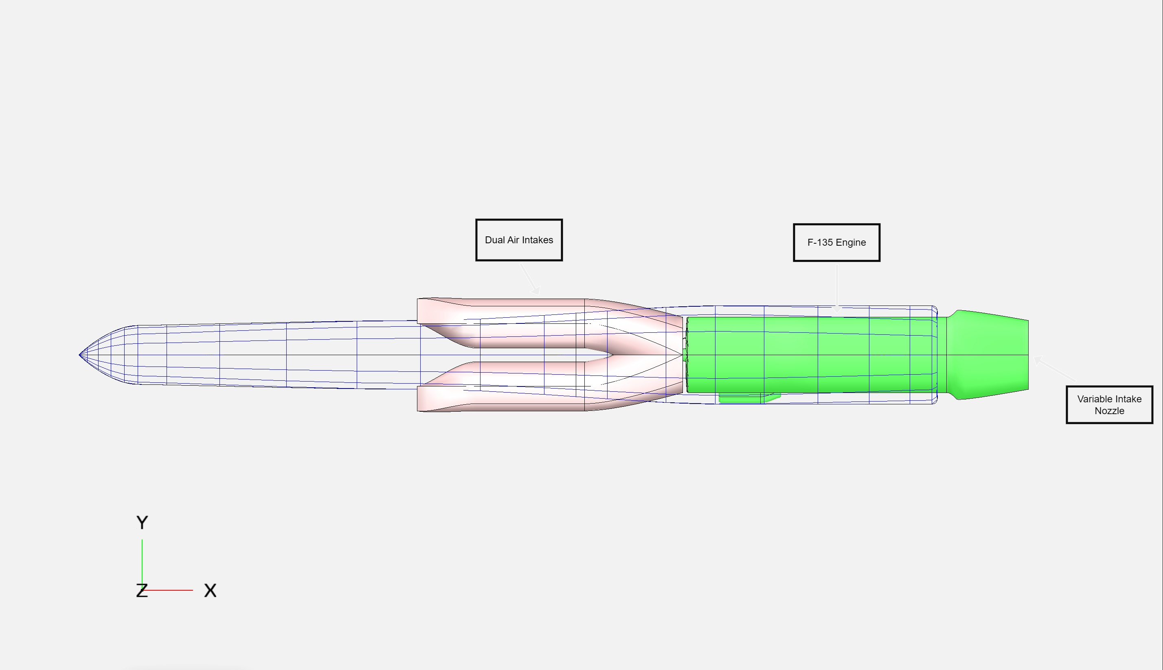
Powertrain

Slide 10
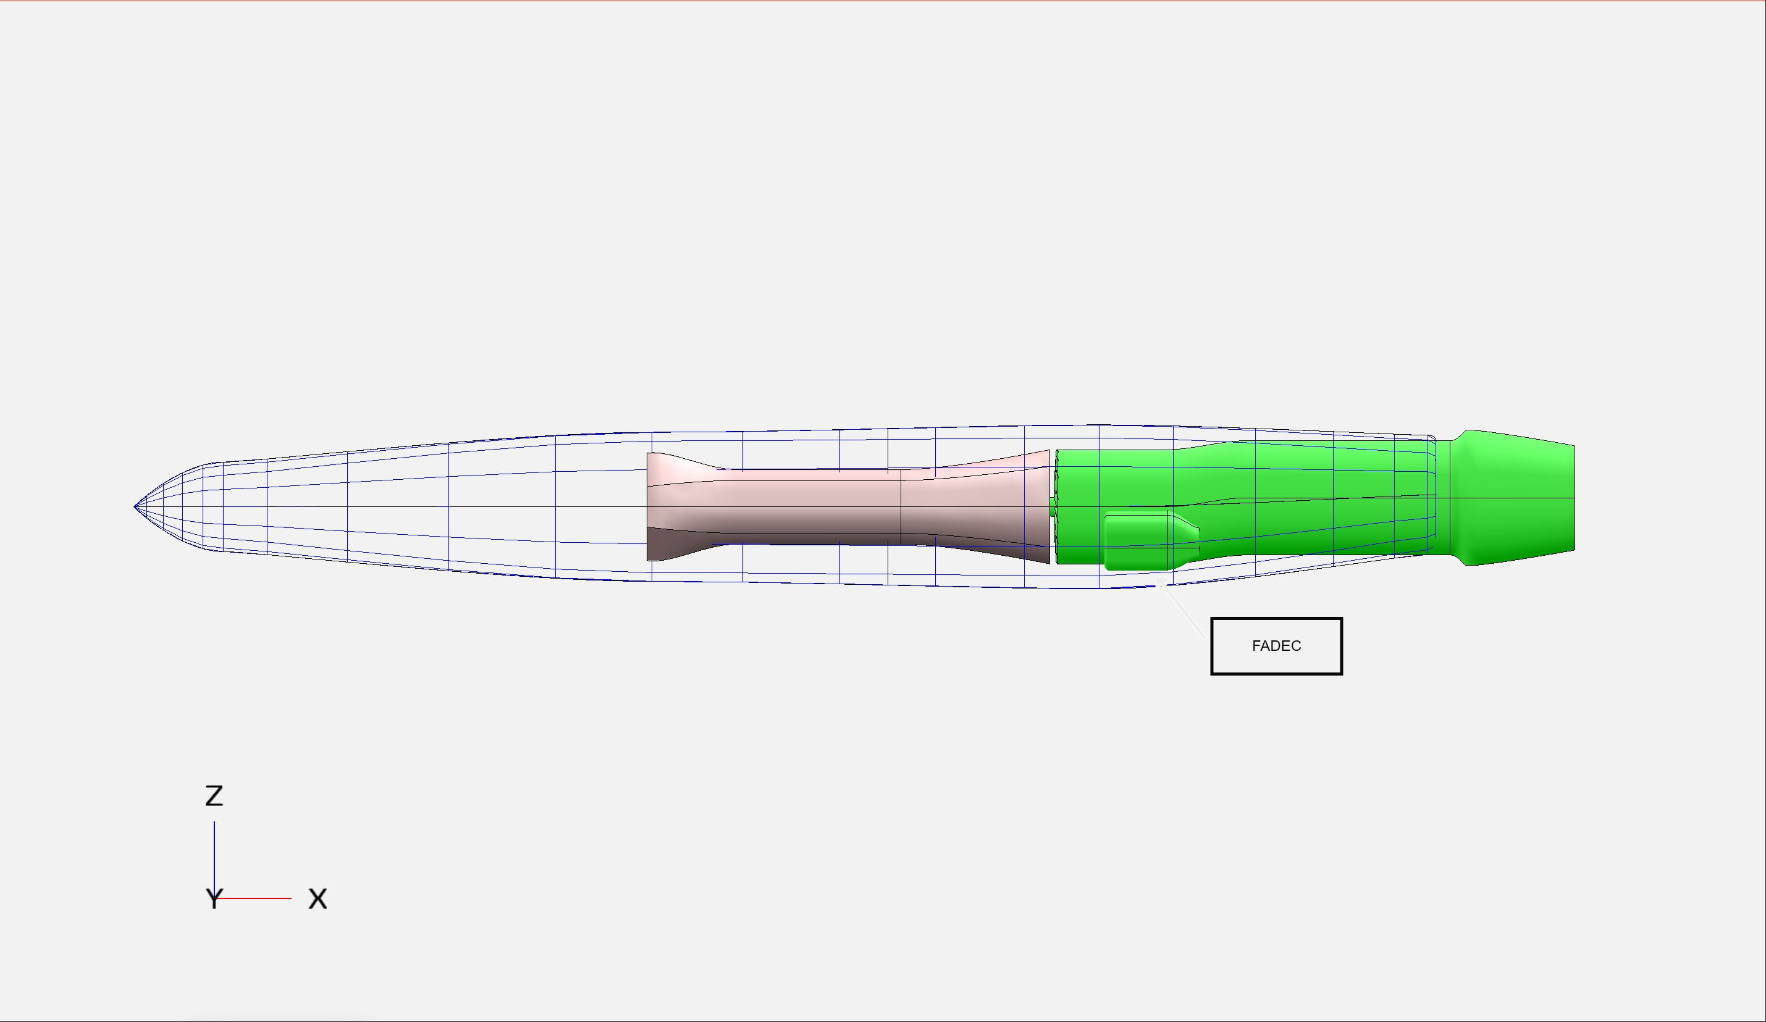
Powertrain

Slide 11
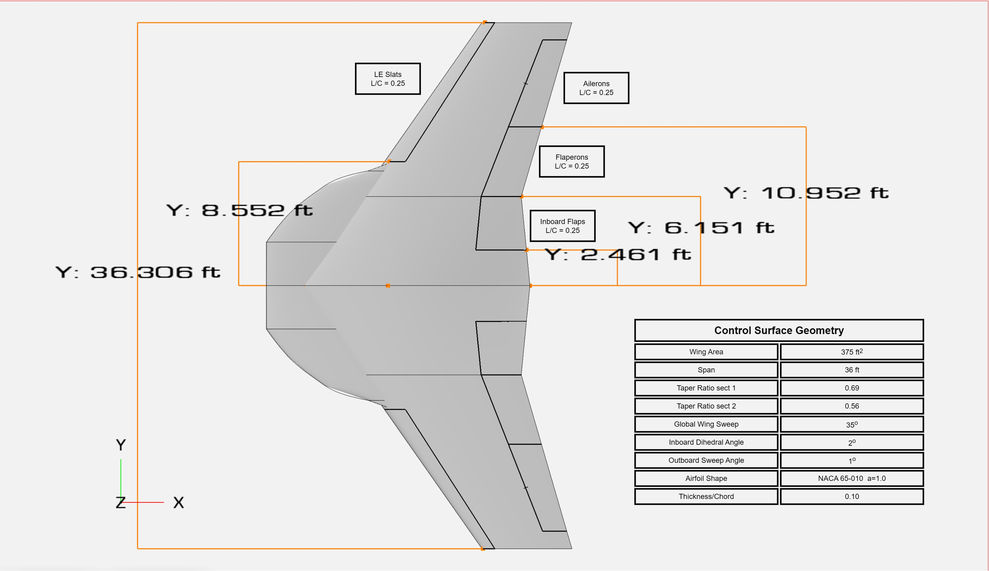
Control Surfaces
400

Slide 12
Empennage (Horizontal)
Notes:
Talk about: redundancy of hstab control surfaces, control authority

Slide 13
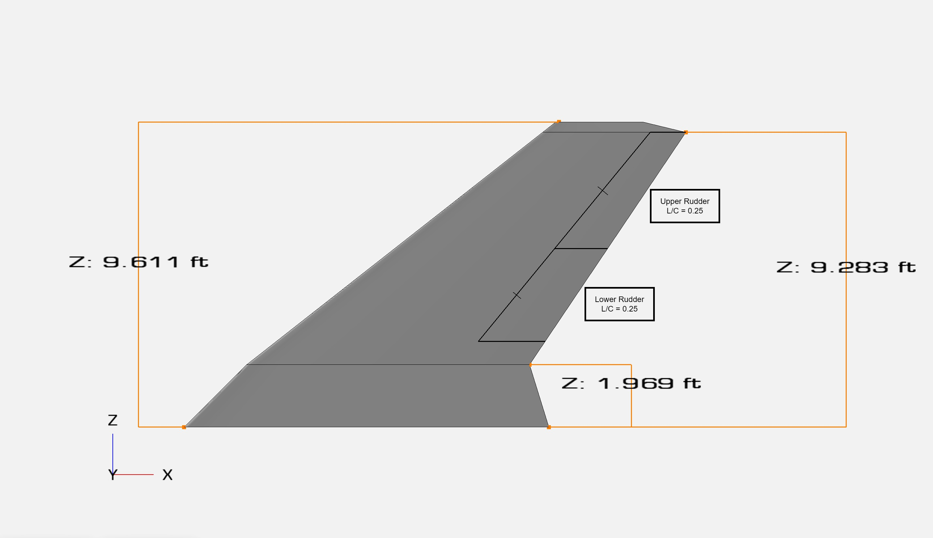
Empennage (Vertical)

Slide 14
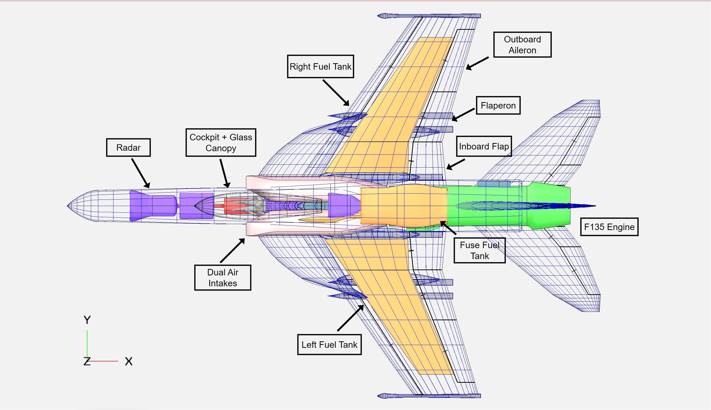
Internal Layout:

Slide 15
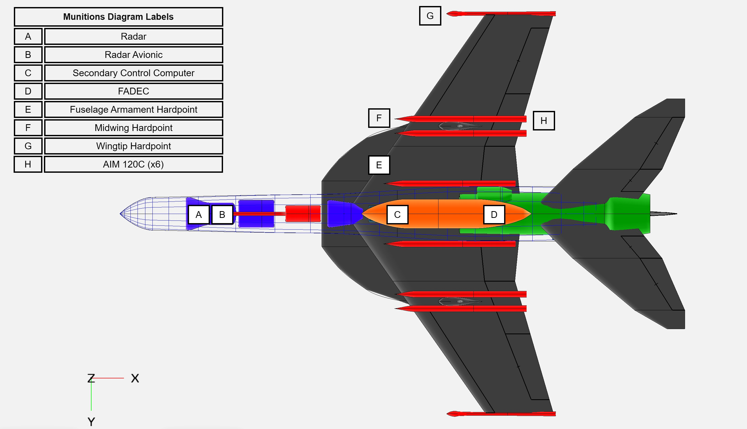
Air Superiority Mission Payload:

Slide 16
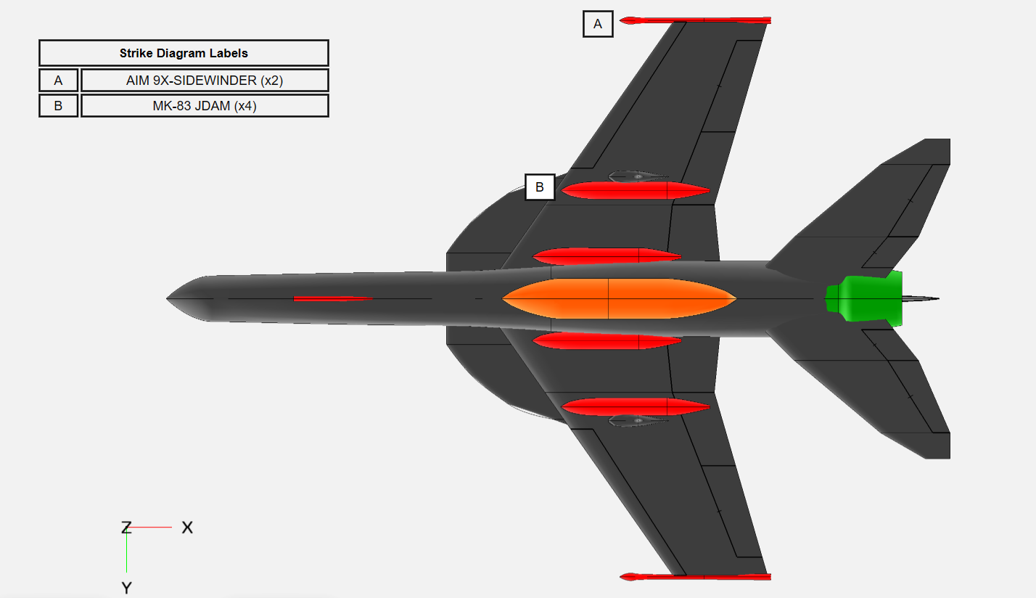
Strike Mission Payload:

Slide 17
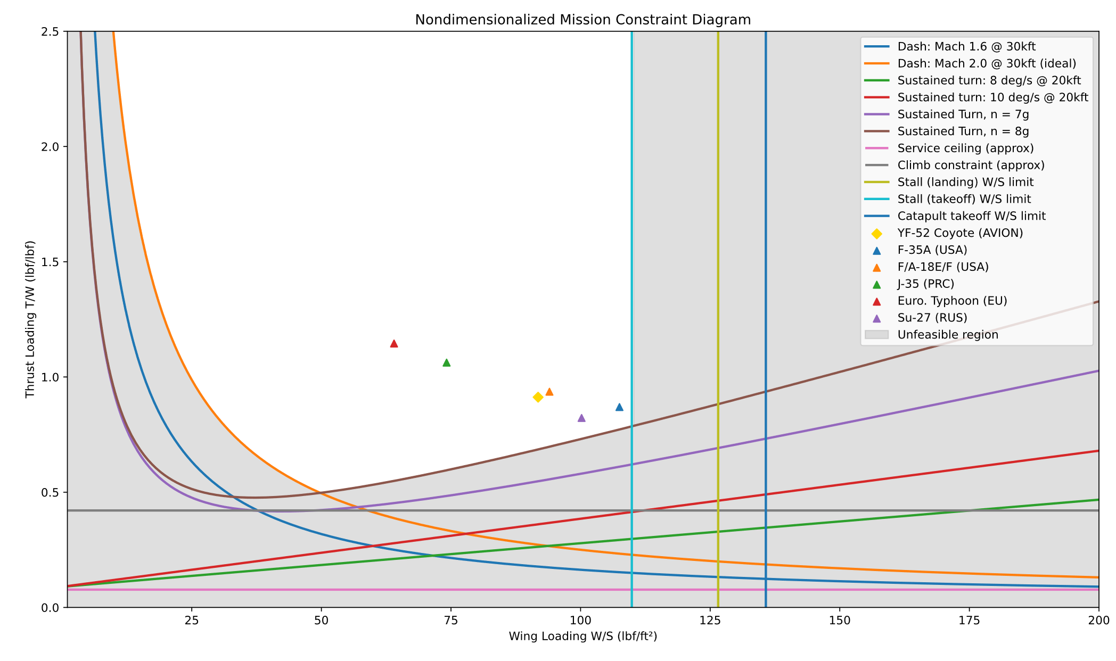
Preliminary Sizing:
Notes:
In order to ensure our aircraft can perform the required missions, a preliminary sizing was completed. First, a non-dimensional analysis was conducted in an effort to find an acceptable thrust/weight and wing loading. Each curve here represents a particular mission constraint, and each chevron denotes historical 5th and 4th generation fighter aircraft. The diamond shows the chosen design point. A thrust loading of 0.93 and wing loading of 90 was chosen, slightly lower than the F-18 super hornet, in an aim to reduce costs while still providing a mission capable aircraft.

Slide 18
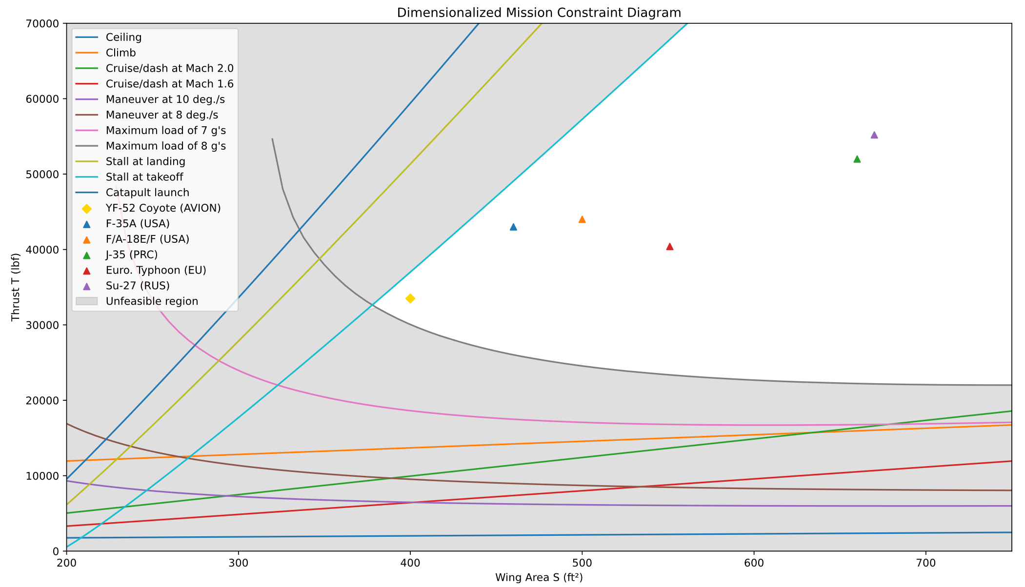
Preliminary Sizing:
Notes:
Subsequently, a dimensionalized sizing was conducted to find a suitable wing area and thrust rating for the design. The same mission constraints were iterated upon in order to find thrust required. Due to our driving constraints, we selected a thrust value of 33500 lb and a wing area of 400 sq ft. The wing area is decreased from previous designs such as the F-35 and F-18, but is still within the same class, to ensure similar handling characteristics and ease of training. The thrust value is lower than both of these aircraft, however, this allows us to use a non-specialized single turbofan engine, reducing costs further. Given our sizing analysis, we are confident an aircraft with these parameters can complete the mission.

Slide 19
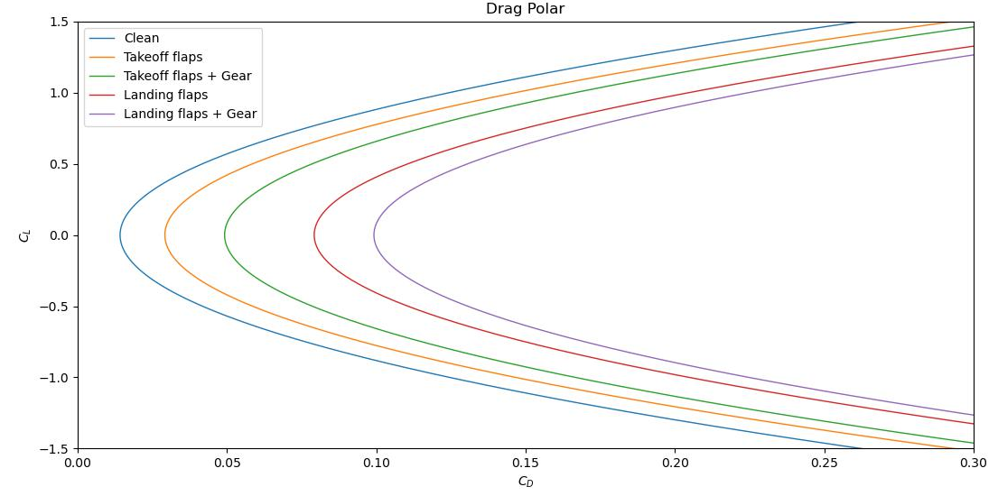
Drag Polar:
Notes:
In order to have a good bearing on aerodynamic efficiency of the aircraft, a drag polar was established. With a fixed aspect ratio of 3.5, efficiency factor and drag were varied for each condition: cruise, takeoff, and landing, and with or without gear down. This reveals satisfactory performance given the provided mission.

Slide 20
How our design meets RFP requirements
Single-engine configuration (F135 class) reduces acquisition and life-cycle cost compared to twin-engine aircraft
Higher thrust-to-weight ratio (~0.91) improves maneuverability and acceleration
Combat radius ≥ 700 nmi achievable through efficient aerodynamic configuration and fuel fraction sizing
Sustained turn performance ≥ 8 deg/s meets maneuverability requirements
Carrier compatible geometry that satisfies both carriers (CVN-68 / CVN-78 ) operations
Mach 2 dash capability exceeds the required Mach 1.6

Slide 21
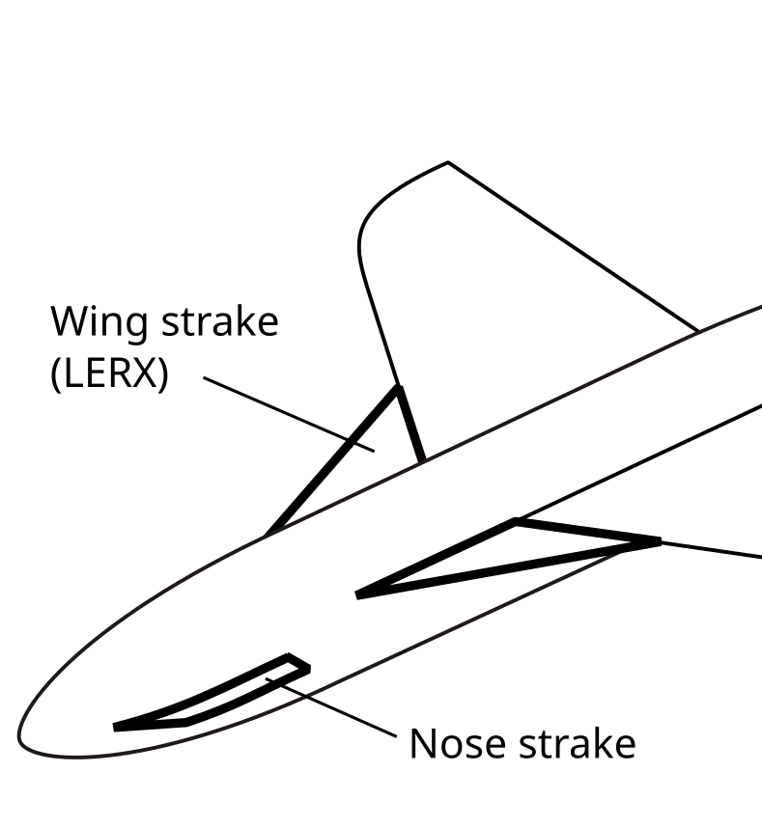
Major Innovations
Strakes/ Leading-edge root extensions
Purpose:
Generate Vortices at high AOA
Delay flow separation
Improve lift and maneuverability
Benefits:
Increased CLmax
Improved dogfight performance
Better carrier landing control
Aircrafts using similar system:
F/A - 18
Sukhoi Su-27
F-16

Slide 22
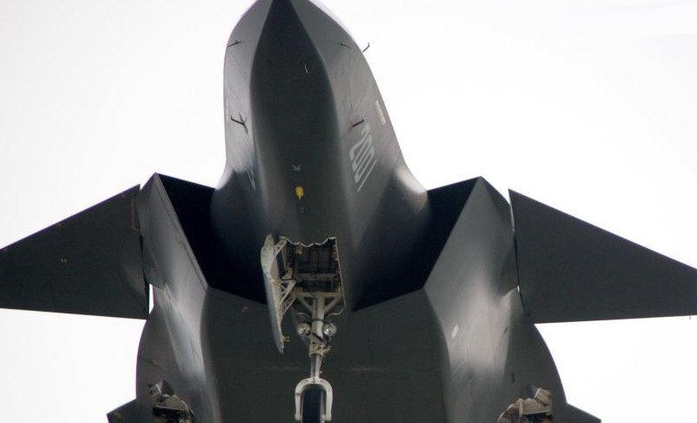
Major Innovations
2. Diverterless supersonic Engine Intakes
Advantages:
Reduce weight
Lower drag
Improved stealth potential
Reduced maintenance costs
Fewer moving components
Aircrafts using similar system:
F-35
Sukhoi Su-75
Chengdu J-20

Slide 23
Risks
Engine failure
Engine Sizing
Auxiliary power unit
Higher consequences
Mitigation:
Use of modern, reliable engine (F135)
Redundant electrical and hydraulic systems
Insufficient performance
Mitigation:
Iterative constraint diagram analysis
Benchmarking against existing fighter engines
Reduced survivability engine failure scenario
Mitigation:
Prioritize APU sizing for enhanced survivability

Slide 24
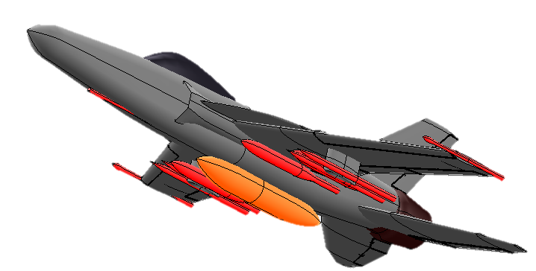
Thank you.

